Slide 1
Classification Test
Multiple Choice – 10 Questions

Slide 2
1.
State the type of scientist who names and classifies things.
a. Ecologist
b. Biologist
c. Taxonomist
d. Zoologist

Slide 3
2) Scientists classify organisms because:
a. it makes it easier to identify organisms.
b. there are only a few organisms that
differ from each other.
c. most discoveries in biology have already
been made.
d. all organisms have characteristics in common.

Slide 4
3) Organisms can be grouped into five major kingdoms. These are:
mammals, fish, birds, amphibians and reptiles.
animals, fungi, monera, plants and protists.
animals, fungi, insects, plants and algae.
d.animals, plants, insects, birds and reptiles.

Slide 5
4) Kingdoms themselves can be sub-divided. The sequence of classification following kingdoms is:
species, phylum, class, order, family, genus.
class, order, family, genus, species, phylum.
order, family, genus, phylum, class, species.
d. phylum, class, order, family, genus, species.

Slide 6
5) A vertebrate is an animal which has:
a. a backbone.
b. a hard shell.
c. wings.
d. fins

Slide 7
6) The reason for using structural characteristics (rather than colour or size) for classification is:
structural features are easy to observe.
individuals of the same type can differ in colour.
organisms change size as they grow.
all of the above.

Slide 8
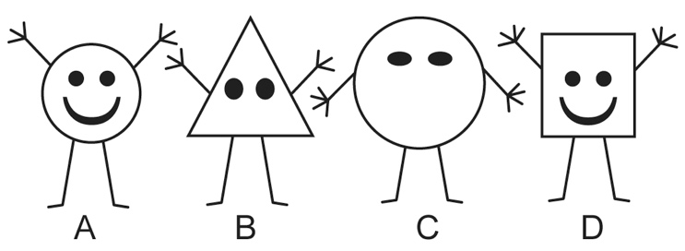
The diagram shows four characters, and a key to identify them.
1 Round body Go to 3.
Not round body Go to 2.
2 Three fingers Gertie 7) Which one is Iris?
Four fingers Iris a. A
b. B
3 Mouth Fred c. C
No mouth Harry d. D

Slide 9
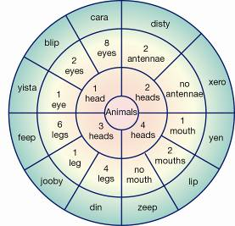
8) Use the circular key below to classify an animal with 6 legs, 4 heads, 8 eyes and no mouth.
a. Feep
b. Xero
c. Cara
d. Zeep

Slide 10
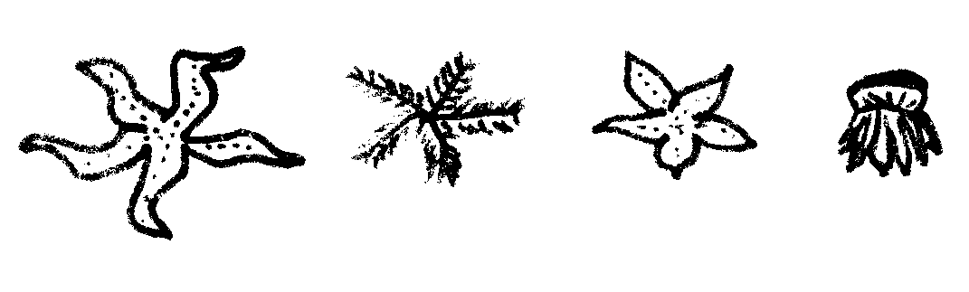
9.) Look at the four sea animals below:
If three (3) of these animals were to be placed in
one group and the remaining one in a separate
group, which one would be in a group by itself?
A
B
C
D

Slide 11
10) Students created this key for their group.
1a Male Go to 2
b Female Go to 5
2a Straight hair Go to 3
b Curly hair Go to 4
3a Can roll tongue Mark
b Cannot roll tongue Yasu
4a Brown eyes Hans
b Grey eyes Jack
5a Straight hair Jane
b Curly hair Mai
Identify the description of Jack.
a) Straight-haired male with brown eyes that cannot role his tongue.
b) Curly-haired male with grey eyes.
c) Male that can roll his tongue and has grey eyes and curly hair.
d) Male with straight hair and brown eyes.

Slide 12
A round dark coloured blob was discovered in a rock pool. List and explain 3 factors or observations which would help decide if it was living or non-living. (6 marks)
List ( provide name of factor) ________________________________________________________________________________
Explanation/Meaning: ________________________________________________________________________________

Slide 13
b. List ( provide name of factor)
_________________________________________
Explanation/Meaning: ________________________________________
_________________________________________
c. List ( provide name of factor) _________________________________________
Explanation/Meaning: __________________________________________________________________________________

Slide 14
If you decided it was living, what would you need to know to decide whether it was a plant or an animal? (1 marks)
___________________________________________________________________________________________________

Slide 15
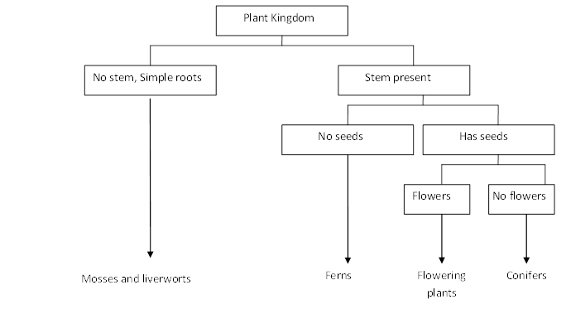
2) The dichotomous key below shows one way of presenting information on the plant
kingdom. Use the key to answer the questions that follow.
List one similarity and one difference between flowering plants and conifers (2 marks)
Similarity
___________________________________________________________________________
Difference
___________________________________________________________________________

Slide 16
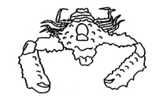
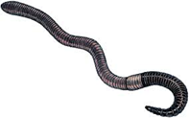
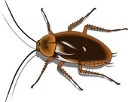
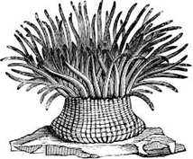
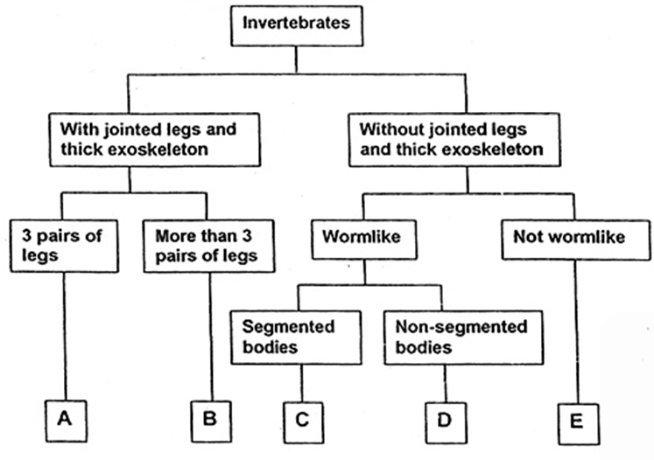
3) Use the key below to classify the animals pictured here. (4 marks)
I II III IV
ANIMAL | GROUP (A,B,C,D or E)
I
II
III
IV

Slide 17
4) Using the 3 creatures below, design a Dichotomous key (minimum of 3 steps) to help identify them based on 2 or more specific characteristics. (3marks)

Slide 18
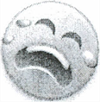
5) Use the key to identify the species name of each of the smileys below then write their name under the correct picture. The first one is done for you. (10 marks)
S.dramaticus

Slide 19
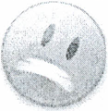


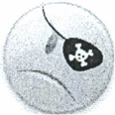

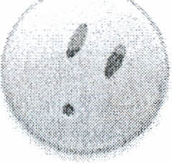



1. Teeth visible …………… go to 2
Teeth not visible........... go to 4
2. Has a wide, toothy smile ……...Smilus toothyus.
Is not smiling……………....go to 3
3. Visibly crying …….Smilus dramaticus
Frowning ..... Smilus upsettus
4. Eyes are symmetrical………….go to 5
Eyes not symmetrical …….. ….go to 8
5. Eyes shaped like hearts …….Smilus valentinus Eyes are shaped as ovals …… go to 6
6. Smiling, happy face…. Smilus traditionalis.
Not happy, frowning or other .... go to 7
7. Mouth curved down, frowning ...Smilus saddus
Mouth is a small circle. ……….Smilus suprisus
8. Has a pirate eye patch………..Smilus piratus
Does not have eye patch……..go to 9
9. One eye is much larger than the other eye ….Smilus mutatus
One eye is winking …….Smilus winkus

